Slide 1

Shadow is Your Friend
from TooMuchBrainProjects
Notes:
Anton

Slide 2
Overview
Project presentation
Product presentation
Team division
Who does what?
Planning
Rough planning
Detailed planning
Problems
Formation
Solution
Basic idea of the game
Graphic design
Programming
Music
Sample of gameplay
Can you break the highscore?
Notes:
Felix

Slide 3
Project
How did we manage the project as a team?
Notes:
Clemens

Slide 4



Team division
Graphic designer & Musician
Programmer
Anton Xaver Edlinger
Valentin Fritz
Clemens Schlipfinger
Felix Schneider
Notes:
Clemens

Slide 5
Planning
Rough planning
Detailed planning
easier: G01, G03, G04
more difficult: G02, G05
good considerations (MUST goals!)
Object Breakdown Structur → consider everything
easier: F03 – F06 (automatic)
more difficult: F01, F02
F01: don‘t forget anything, otherwise consequences
F02: a total of 35 work packages
Notes:
Valentin

Slide 6
Problems
Formation
Solution
Time “wasted“ at Movement (too much invested)
no color palette (no main color and secondary color)
no standardization in design
no agreement who makes music
other work packages have less time + Clemens works overtime
everything black / white dddddddddddddddddddddddddd
more communication
both make music
Notes:
Felix

Slide 7
Product
What product did we actually produce?
Notes:
Anton

Slide 8
Basic idea of the game ShadowIsYourFriend
Single-Player-Game
2D Stealth Game (you have to dodge the lights)
different light sources:
Lantern
Guard with flashlight
Camera (also shown as a light cone)
Endless mode: in theory, you can keep playing endlessly
Difficulty increases with distance
Notes:
Anton

Slide 9

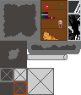




Graphic design ShadowIsYourFriend
Player-Design:
Idle
Jump
Crouch
Run
Death
Guard-Design:
Idle
Walking
Camera-Design:
Holder
Camera
Lamp-Design:
AttentionLevel:
Heart
Bar
Stage-Design:
Background:
Game-BG:
Menu-BG:
Notes:
Valentin

Slide 10
Programming ShadowIsYourFriend
Movement:
State-Machine:
Idle
Run
Jump
Fall
Crouch
Death
so smooth as possible (not enough time)
because of State-Machine → music easier to implement
Stealth-Mechanics:
State-Machine:
Invisible
Visible
DroppingVisible
Recognised
switches between different scenarios (not seen / seen / heal / dead)
Menus:
MainMenu
OptionsMenu
PauseMenu
GameOver
operable with mouse and keyboard
Options:
Volume
reset highscore
Score:
the further you go, the higher the score
with distance more and more difficulty, because less lives
UI displaying score and highscore
Notes:
Clemens

Slide 11
Musik ShadowIsYourFriend
Title music: plays in MainMenu and OptionsMenu
Game music normal: plays in game (when all lives)
Game music dramatic: plays in game (when in danger)
PauseMenu: music becomes quieter
OptionsMenu: music volume changeable
Notes:
Felix

Slide 12
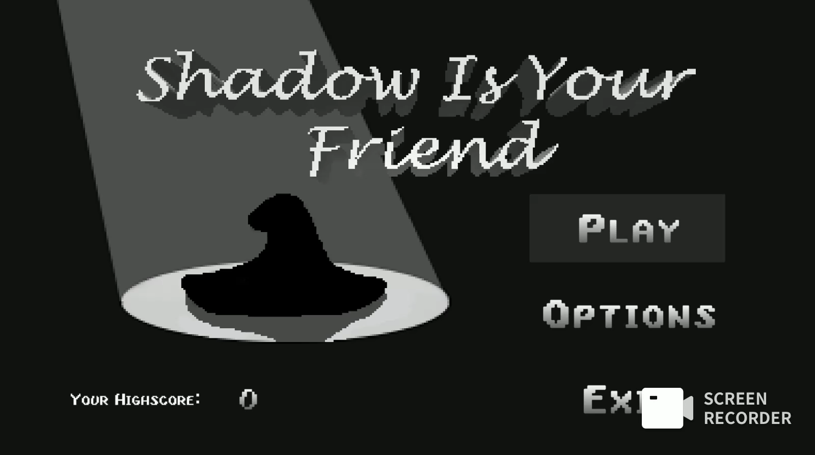
Notes:
Felix

Slide 13


Thank you for your attention! Feel free to ask questions now!
Notes:
Felix

